Slide 1
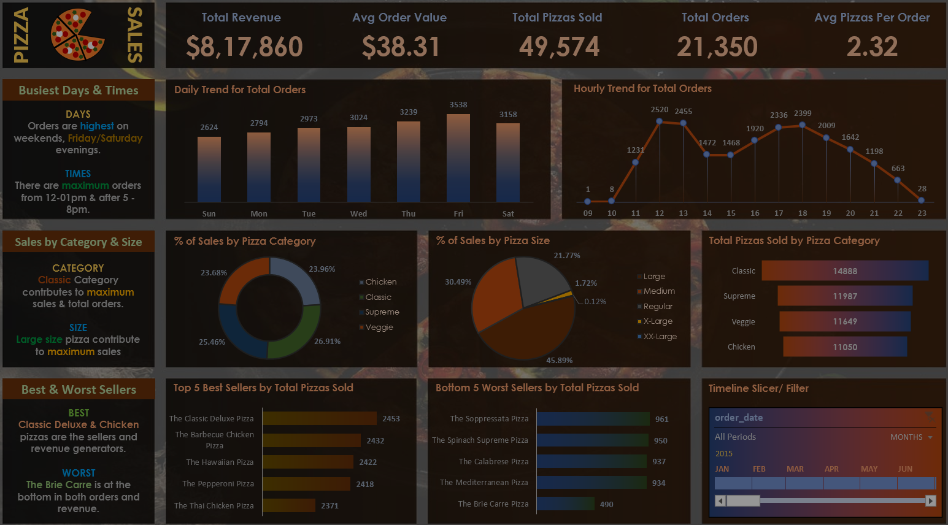
🍕PIZZA SALES REPORT
(SQL + TABLEAU)

Slide 2
This report presents a detailed analysis of pizza sales data for the year 2015. It encompasses key performance metrics such as total revenue, order volume, sales by pizza category and size, customer buying patterns, and product-level performance.
By examining trends across different time periods and product segments, the report aims to uncover valuable business insights that can drive data-informed decisions related to product strategy, marketing, and operations.
The insights provided will help in identifying best-selling pizzas, understanding peak sales hours, and highlighting opportunities for improving underperforming items, ultimately contributing to better customer satisfaction and increased profitability
🍕Introduction

Slide 3
Analyze pizza sales performance across various categories, sizes, and timeframes during the year 2015.
Identify top-performing and underperforming products to support menu optimization and informed inventory planning.
Understand customer purchasing behavior based on order timing, quantity, and preferences.
Highlight sales trends to aid in strategic marketing decisions, including promotional planning during peak hours and high-demand periods.
Provide actionable insights to help the business enhance customer experience, boost revenue, and improve operational efficiency.
🍕OBJECTIVE

Slide 4
PROBLEM STATEMENT
KPI’s REQUIREMENT
We need to analyze key indicators for our pizza sales data to gain insights into our business performance. Specifically, we want to calculate the following metrics:
Total Revenue: The sum of the total price of all pizza orders.
Average Order Value: The average amount spent per order, calculated by dividing the total revenue by the total number of orders.
Total Pizzas Sold: The sum of the quantities of all pizzas sold.
Total Orders: The total number of orders placed.
Average Pizzas Per Order: The average number of pizzas sold per order, calculated by dividing the total number of pizzas sold by the total number of orders.

Slide 5
PROBLEM STATEMENT
CHARTS REQUIREMENT
We would like to visualize various aspects of our pizza sales data to gain insights and understand key trends. We have identified the following requirements for creating charts:
Hourly Trend for Total Pizzas Sold:
Create a stacked bar chart that displays the hourly trend of total orders over a specific time period. This chart will help us identify any patterns or fluctuations in order volumes on a hourly basis.
2.Weekly Trend for Total Orders:
Create a line chart that illustrates the weekly trend of total orders throughout the year. This chart will allow us to identify peak weeks or periods of high order activity.
3.Percentage of Sales by Pizza Category:
Create a pie chart that shows the distribution of sales across different pizza categories. This chart will provide insights into the popularity of various pizza categories and their contribution to overall sales.

Slide 6
PROBLEM STATEMENT
CHARTS REQUIREMENT
4.Percentage of Sales by Pizza Size:
Generate a pie chart that represents the percentage of sales attributed to different pizza sizes. This chart will help us understand customer preferences for pizza sizes and their impact on sales.
5.Total Pizzas Sold by Pizza Category:
Create a funnel chart that presents the total number of pizzas sold for each pizza category. This chart will allow us to compare the sales performance of different pizza categories.
6.Top 5 Best Sellers by Revenue, Total Quantity and Total Orders
Create a bar chart highlighting the top 5 best-selling pizzas based on the Revenue, Total Quantity, Total Orders. This chart will help us identify the most popular pizza options.
7. Bottom 5 Best Sellers by Revenue, Total Quantity and Total Orders
Create a bar chart showcasing the bottom 5 worst-selling pizzas based on the Revenue, Total Quantity, Total Orders. This chart will enable us to identify underperforming or less popular pizza options.

Slide 7


Total Revenue:
SELECT ROUND(SUM(od.quantity * p.price), 2) AS total_revenue
FROM orders_details AS od
JOIN pizzas AS p ON od.pizza_id = p.pizza_id;
Average Order Value:
SELECT ROUND((SUM(od.quantity * p.price))/COUNT(Distinct order_id), 2) AS Avg_order_spent
FROM orders_details AS od
JOIN pizzas AS p ON od.pizza_id = p.pizza_id;
🍕SQL QUERIES

Slide 8



Total Pizzas Sold:
SELECT SUM(quantity) AS Total_Pizza_Sold
FROM orders_details;
Total Orders:
SELECT COUNT(order_id) AS Total_orders
FROM orders;
Average Pizzas Per Order:
SELECT ROUND(SUM(quantity) / COUNT(DISTINCT order_id),2)
AS Avg_pizzas_per_order
FROM orders_details;
🍕SQL QUERIES

Slide 9
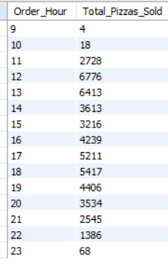
Hourly Trend for Total Pizzas Sold:
SELECT
HOUR(o.order_time) AS order_hours,
SUM(od.quantity) AS total_pizzas_sold
FROM
orders AS o
JOIN
orders_details AS od ON o.order_id = od.order_id
GROUP BY HOUR(o.order_time)
ORDER BY HOUR(o.order_time);
🍕SQL QUERIES

Slide 10
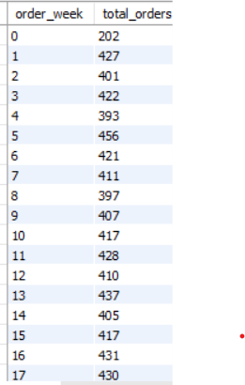
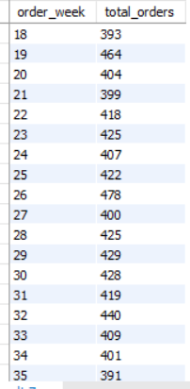
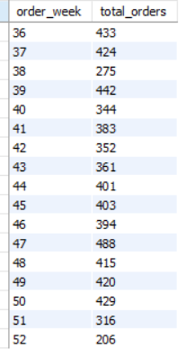
Weekly Trend for Orders:
SELECT
WEEK(order_date) AS order_week,
COUNT(order_id) AS total_orders
FROM
orders
GROUP BY order_week;
🍕SQL QUERIES

Slide 11
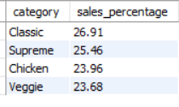
Percentage of Sales by Pizza Category:
SELECT pt.category, ROUND(SUM(od.quantity * p.price) * 100/ (SELECT
SUM(od.quantity * p.price)
FROM
orders_details AS od
JOIN
pizzas AS p ON od.pizza_id = p.pizza_id ),2) AS sales_percentage FROM orders_details AS od
JOIN pizzas AS p ON od.pizza_id = p.pizza_id
JOIN pizza_types as pt ON pt.pizza_type_id = p.pizza_type_id
GROUP BY pt.category
ORDER BY sales_percentage desc;
🍕SQL QUERIES

Slide 12
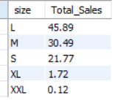
Percentage of Sales by Pizza Size:
SELECT p.size,
ROUND(SUM(od.quantity * p.price) * 100 / (SELECT
SUM(od.quantity * p.price)
FROM orders_details AS od JOIN
pizzas AS p ON od.pizza_id = p.pizza_id),2) AS Total_Sales
FROM
orders_details AS od
JOIN
pizzas AS p ON od.pizza_id = p.pizza_id
GROUP BY p.size
ORDER BY Total_Sales DESC;
🍕SQL QUERIES

Slide 13
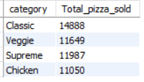
F. Total Pizzas Sold by Pizza Category:
SELECT pt.category, SUM(od.quantity) AS Total_pizza_sold
FROM pizza_types AS pt
JOIN pizzas AS p ON p.pizza_type_id = pt.pizza_type_id
JOIN orders_details AS od ON p.pizza_id = od.pizza_id
GROUP BY pt.category;
🍕SQL QUERIES

Slide 14
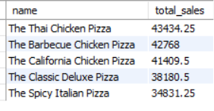
Top 5 Pizzas by Revenue:
SELECT pt.name, ROUND(SUM(od.quantity * p.price), 2) AS total_sales
FROM orders_details AS od
JOIN pizzas AS p ON od.pizza_id = p.pizza_id
JOIN pizza_types AS pt ON p.pizza_type_id = pt.pizza_type_id
GROUP BY pt.name
ORDER BY total_sales DESC
LIMIT 5;
🍕SQL QUERIES

Slide 15
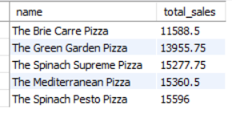
Bottom 5 Pizzas by Revenue:
SELECT pt.name, ROUND(SUM(od.quantity * p.price), 2) AS total_sales
FROM orders_details AS od
JOIN pizzas AS p ON od.pizza_id = p.pizza_id
JOIN pizza_types AS pt ON p.pizza_type_id = pt.pizza_type_id
GROUP BY pt.name
ORDER BY total_sales
LIMIT 5;
🍕SQL QUERIES

Slide 16
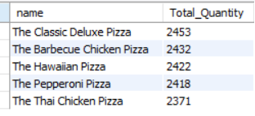
Top 5 Pizzas by Quantity:
SELECT pt.name, SUM(quantity) AS Total_Quantity
FROM orders_details AS od
JOIN pizzas AS p ON od.pizza_id = p.pizza_id
JOIN pizza_types AS pt ON p.pizza_type_id = pt.pizza_type_id
GROUP BY pt.name
ORDER BY Total_Quantity DESC
LIMIT 5;
🍕SQL QUERIES

Slide 17
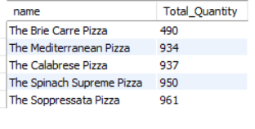
Bottom 5 Pizzas by Quantity:
SELECT pt.name, SUM(quantity) AS Total_Quantity
FROM orders_details AS od
JOIN pizzas AS p ON od.pizza_id = p.pizza_id
JOIN pizza_types AS pt ON p.pizza_type_id = pt.pizza_type_id
GROUP BY pt.name
ORDER BY Total_Quantity
LIMIT 5;
🍕SQL QUERIES

Slide 18
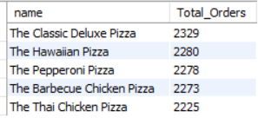
Top 5 Pizzas by Total Orders:
SELECT pt.name, COUNT(DISTINCT od.order_id) AS Total_Orders
FROM orders_details AS od
JOIN pizzas AS p ON od.pizza_id = p.pizza_id
JOIN pizza_types AS pt ON p.pizza_type_id = pt.pizza_type_id
GROUP BY pt.name
ORDER BY Total_Orders DESC
LIMIT 5;
🍕SQL QUERIES

Slide 19
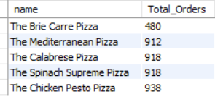
Bottom 5 Pizzas by Total Orders:
SELECT pt.name, COUNT(DISTINCT od.order_id) AS Total_Orders
FROM orders_details AS od
JOIN pizzas AS p ON od.pizza_id = p.pizza_id
JOIN pizza_types AS pt ON p.pizza_type_id = pt.pizza_type_id
GROUP BY pt.name
ORDER BY Total_Orders
LIMIT 5;
🍕SQL QUERIES

Slide 20
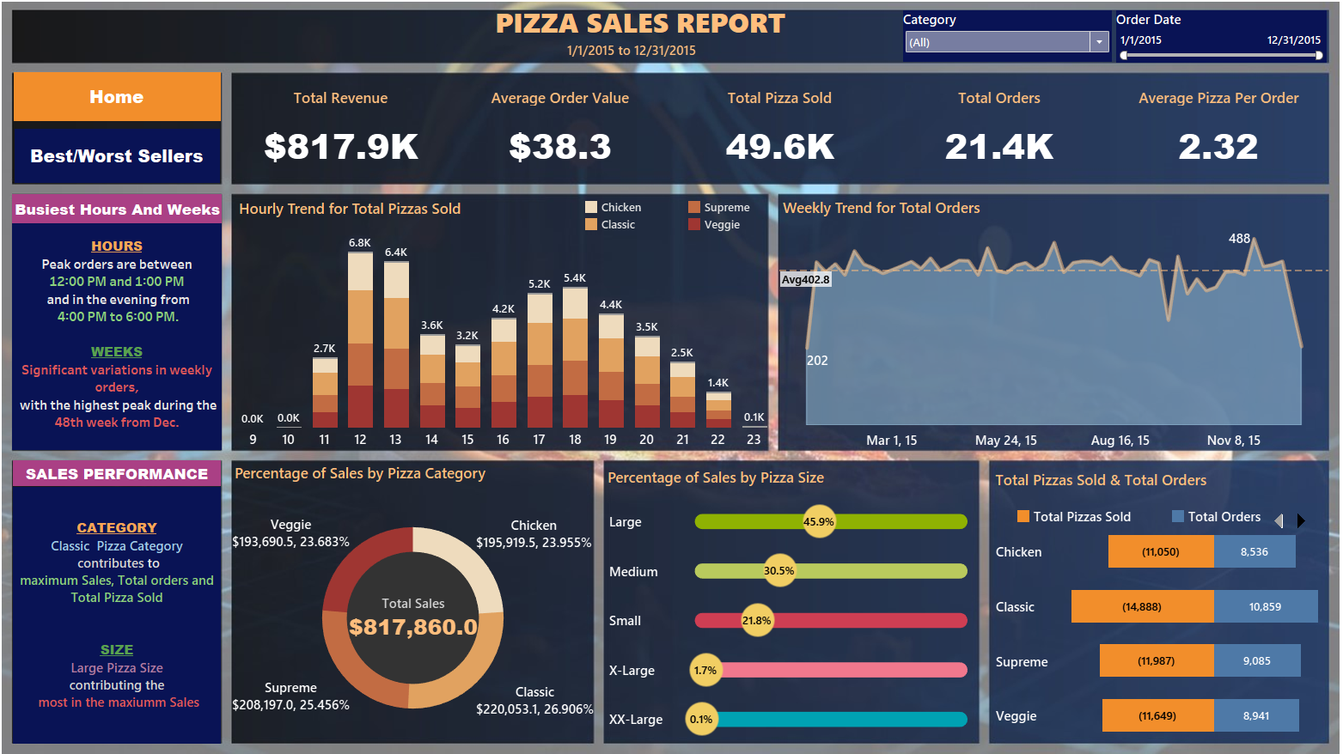

Slide 21
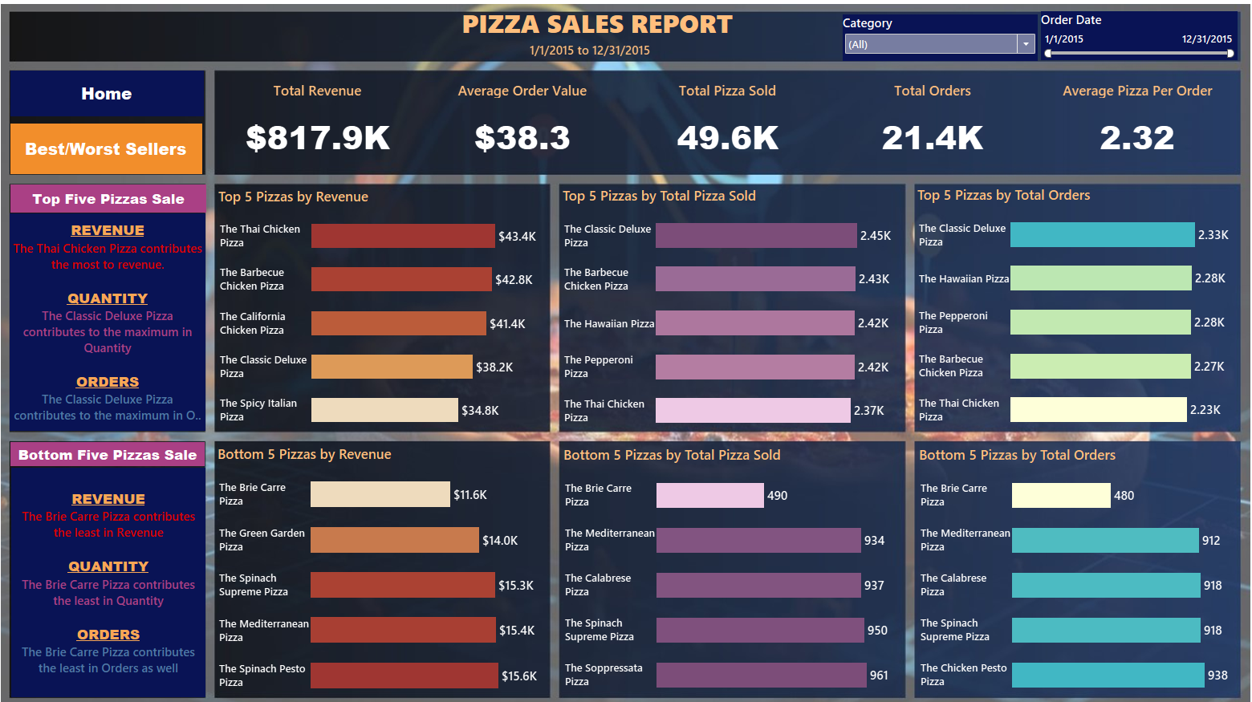

Slide 22
Key Highlights:
📦 Total Orders: 21.4K | 🍕 Pizzas Sold: 49.6K
💰 Total Revenue: $817.9K | 🧾 Avg. Order Value: $38.3
🏆 Top-Selling Pizza: Classic Deluxe (2.45K units, $38.2K revenue)
📊 Best-Performing Category: Classic – leading in all KPIs
🍕 Preferred Size: Large – accounting for nearly 46% of total revenue
Customer Behaviour & Trends:
⏰ Peak Hours: 12–1 PM (lunch) and 4–6 PM (evening)
📈 Sales Peak: Week 48 (late December) – holiday season impact
🧾 Average Pizzas per Order: 2.32 – indicating multi-pizza purchases
🍕INSIGHT REPORT

Slide 23
Promote top-sellers and bundle with preferred sizes (e.g., large Classic pizzas).
Leverage peak sales hours with targeted discounts or loyalty offers.
Re-evaluate low-performing items like Brie Carre for optimization or replacement.
Plan seasonal marketing campaigns around the end of the year and weekends.
🍕RECOMMENDATION

